Slide 1
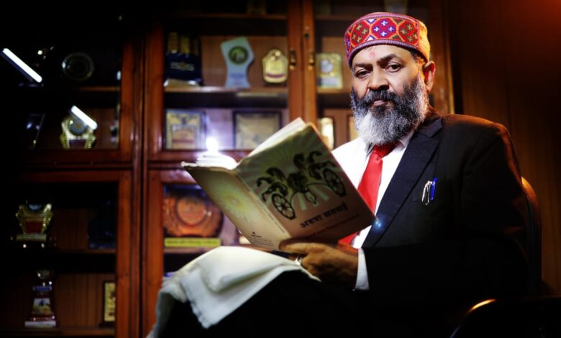
WELCOME
TO
NAAC PEER TEAM
Prof. Arun Diwaker Nath Bajpai (Chairperson)

Slide 2
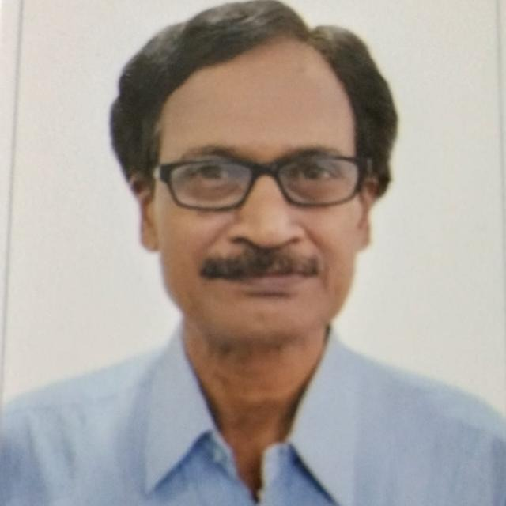
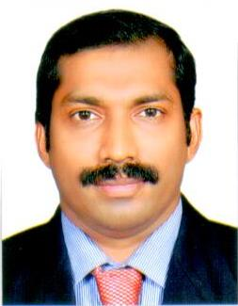
WELCOME
TO
NAAC PEER TEAM
Prof. Venkatraman Ardhanary (Member) Prof. M.P. Rajan (Member)
Prof. Venkatraman Ardhanary (Member)
Prof. Rajan M P(Member)

Slide 3
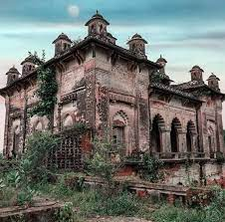
M.H.M. College, Sonbarsa is maintained by MHRD under the program ‘All India Survey of Higher Education’. We represent the same facts in a user-friendly way. If you’re looking for more details regarding admission/application forms, syllabus, courses offered, results or examinations schedule, kindly contact the relevant department of the college.
In order to provide good quality higher education to the people of Sonbarsa Raj situated in the Kosi region, the royal family of the region envisioned to set up a college soon after the independence of the India. Hon. Ambika Prasad Singh, a royal family member, made serious attempts to establish a college but unfortunately could not succeed. The present institution (M.H.M College) was finally set up by the Honourable Dr. Arjun Kumar Singh, a descendent of the Sonbarsa Raj royal family on May 20, 1969.
Maharaja Harivallabh Narayan Singh of Sonbarsa Raj

Slide 4
Maharaja Harivallabh Memorial College, Sonbarsa (Saharsa) (A Constituent Unit of B.N. Mandal University, Madhepura)
Recognized under 2 (f) in 08/02/1983 & 12 (B) in 08/02/1983 of UGC Act

Slide 5
COLLEGE PROFILE
Name of the institution | College M.H.M. College, Sonbarsa (Saharsa)
Establishment | 01.06.1969
UGC recognition | Under 2(f): 08/02/1983, 12(B):08/02/1983
Affiliating University | Bhupendra Narayan Mandal, University, Madhepura
College Status | Not NAAC Accredited
AISHE ID | C-29639
Institution Track ID | BRCOGN103299
Type of College | Co-education
No of Department | 16
Location | Rural
Area of the Campus | 13 Acre
Total Number of Permanent Teachers | 08
Total Number of Guest Teachers | 03
Total Number of Offering Teachers | 07
Total Number of Non teaching | 7
Total number of students | (UG -3018) Semester-I=1025, Part-II=1068, Part-III=926

Slide 6
VISION
MISSION
To provide access to quality higher education to the youth.
To ensure social justice, equity and commitment to national priorities.
To promote competence to address challenges in a fast changing world.
Intellectual, spiritual and physical growth of all stakeholders through pursuit of excellence in learning.

Slide 7
CURRICULAR ASPECTS

Slide 8
CURRICULUM DESIGN AND DEVELOPMENT
DESIGN:
Feedback from Students, Alumni & any desired person.
MECHANISM: Online feedback is being facilitated by College official website and also offline feedback system is being facilitated by complaint box from all the above aforesaid person or association.
DEVELOPMENT:
CBCS syllabus introduced from 2023-24.
Syllabus has been provided by the Govt. of Bihar.
10 CGPA points as per CBCS.

Slide 9
ACADEMIC PROGRAMME
Science : 05 Core Subjects
Arts :04 Core Subject.
Humanities :07 Core Subject.
VAC :10
SEC :05
AEC :04
SELF FINANCING COURSES : 01
(Applied for approval to AICTE)
BCA

Slide 10
ACADEMIC FLEXIBILITY
HUMANITIES
Hindi/Sanskrit/Maithili/English/Urdu/Philosophy
Social Scinece
Home Science/Political Science/Sociology/Economics//History
SCIENCE
P PHYOJUSDNLSFJSOFJ Physics/Chemistry/Botany/Zoology/Mathematics
Academic Flexibility under CBCS system in core, AEC Ability Enhance Course, MDC (Multidisciplinary Course), VAC (Value Added Course)
Credit transfer facility in CBCS

Slide 11
SKILL DEVELOPMENT PROGRAMME
SKILL ENHANCEMENT COURSE HAS BEEN PROVIDED VIA CBCS SYSTEM.

Slide 12
CURRICULUM ENRICHMENT
Approval for New Programs BCA has been sent to AICTE in March 2024.
Skill development Programme, Value added Courses & Ability enhancement Course introduced via CBCS.
Proposal Submitted for B.Ed., B.P.Ed., YOGA, BLISS & P.G. (Science & Art) to the Department of Higher Education, Govt. of Bihar after due consideration with Senate & Syndicate of B.N. Mandal University, Madhapura.

Slide 13
FEEDBACK SYSTEM
ONLINE /OFF-LINE FEEDBACK SYSTEM FROM :
STUDENT
FACULTY:
ALUMNI
EMPLOYERS & INDUSTRILIST
ACTION TAKEN ON CURRICULUM:
SKILL ENHANCEMENT COURSES
Value Added Courses
Ability Enhancement Courses
TRANSLATION (HINDI TO ENGLISH & ENGLISH TO HINDI)
TWINNING UG PROGRAMME
REMEDIAL COACHING
TEACHING IN SMART CLASS

Slide 14
TEACHING-LEARNING AND EVALUATION

Slide 15
STUDENT ENROLLMENT AND PROFILE
Admission through University Management Information System(B.N.M.U. Madhepura)
Admission details is available online
Advertisement in Print ,Electronic media & Website
On-line submission of Application forms
Publication of selection list by admission portal of UMIS
SMS alert from College
Merit List Publication in website
Admission & Counselling, Grievance & Discipline, Cultural & Sports, IT & Public Relation and Media Cells are conducted by various committee.

Slide 16
STUDENT DIVERSITY
Orientation /Introduction Programme for freshers
English Language classes for vernacular students
Remedial Coaching
Doubt removal classes
Motivation for Advanced learners, Prizes & Awards
Seminar Presentation
Facilities for Catering to the need of differently- abled students & Scholarship

Slide 17
TEACHING LEARNING PROCESS
Academic calendar followed.
Lesson Plan & Progress register is maintained by teachers.
Apart from Lecture Method : Practical classes/Field study/Science Exhibition/group discussion/creative writing are also practiced.
E-learning ,virtual groups.
Co- Curricular activity for holistic development.
Dance/music/Art & painting for nurturing creativity.
Continuous examination and evaluation.
Hand notes, study materials & web links.
Mentoring to all students.
Project Preparation & Seminar.

Slide 18
TEACHER QUALITY
Number of Teachers | 18, Male – 17, Female-01
Ph.D. | 06
M.Phil. | 01
Pursuing Ph.D. | 04
Research Supervisor | 03
Awards and Special Recognition | 01
Research Articles Published | 29
Seminar Attended | Total- 37 (National-29/ International-08)
International Conference Attended | 04
Paper presented | 26
CSIR-UGC NET | 01
UGC NET | 06
BET | 01

Slide 19
STAFF DEVELOPMENT PROGRAMME
Refresher Course attended | 39
Orientation Programme attended | 12
Faculty Development Programme attended | 05
Staff attended training Programme organized by University and other colleges | 05
Staff attended Summer/Winter/Workshop | 08
CBCS /IQAC | 05

Slide 20
ACADEMIC DEVELOPMENTS
Author of Text/Reference/Edited books : 17
Seminars organized :
National Seminar/Webinar :02

Slide 21
EVALUATION PROCESS & REFORMS
P
R
O
C
E
S
S
Question Setting
(Internal)
Moderator
Questions in various sets
Examination Controller
Central
Evaluation
Conducting Internal Exmaination
Result
REFORMS
Photocopy of answer script on demand

Slide 22
RESEARCH CONSULTANCY & EXTENSION

Slide 23
CONSULTANCY
Policy: Individual level and Non-Revenue nature
Dept of Zoology : On Vermiculture to local farmers through students.
Dept of Botany : From Lab to Land through students
IQAC : Help other colleges on IQAC and preparation of SSRs for NAAC

Slide 24
EXTENSION AND INSTITUTIONAL SOCIAL RESPONSIBILITY
02 State level talent recognition awards by NCC.
NSS, State level prize by NSS Volunteer.
Self defense for girls
Computer training to students.
Plantation in 2 acres of land.
Annual Van Mohotsav.
Disaster Management Training by NSS/NCC.
Health, sanitation and education.
Beti Bachao & Beti Padhao Abhiyan
Swachh Bharat Abhiyan

Slide 25
INFRASTRUCTURE AND LEARNING RESOURCES
PHYSICAL
LIBRARY
Infra
IT

Slide 26
PHYSICAL INFRASTRUCTURE
TOTAL BUILT UP AREA: 13 Acre.
ACADEMIC BLOCK: Class Rooms (9) & Smart class rooms(01)
LABORATORIES & COMPUTER LAB: Art & Science Laboratories (05), Computer Lab. (01), ICT Lab (1).
ADMINISTRATIVE BLOCK: Accounts ,Examination, Principal’s Office and Admission Section.
LEARNING CENTRES: Library & E-Library
SPORTS FACILTY: Outdoor stadium for Football, Volleyball & Cricket, GYM, YOGA
SPIRITUAL CENTRE: Yoga Centre – 02 Acre
COMMON ROOM: Girls/Teachers
OTHER FACILITIES:
Grievance Redressal Cell , Student’s Union Room, Alumni Association, Woman Harassment Cell Canteen (01), Sick Room
# A new Academic Block is under construction of 4000 sq ft.

Slide 27
LIBRARY AS A LEARNING RESOURCE
High Speed Internet connectivity of JIO
Built up area : Within College Campus
Text books : 9600
Reference books : 1000
Text/Reference CDs : 500
Question Bank : 150
Student Reading Room : 20 capacity
Staff Reading Room : 10 Capacity
Issue and Return of books : Software based

Slide 28
IT INFRASTRUCTURE
Wi-Fi campus (100 Mbps)
Computer Lab with 20 PCs with Internet connectivity.
01 computer labs.
01 smart classrooms and 04 Science Labs with LCD projector.
IT-enabled Accounts /Establishment & Admission section.
IT based Library access system.
Salary through Online Treasury Management solution via Univeristy.
Exam Management Solution System.
Technician: For equipment maintenance.

Slide 29
STUDENT SUPPORT & PROGRESSION

Slide 30
STUDENT MENTORING & SUPPORT
Counseling for choosing core & elective subjects.
Extension Cell Units (NCC-1 , NSS – 1)
Syllabus, College Academic Calendar published in website.
Career counseling.
Grievance redressal mechanism.
Sexual harassment redressal cell

Slide 31
Anti-Ragging Cell
Sanitary napkin dispensing units in Girl’s Common Room
Awards and Prizes for Academic Performance
Cultural and Literary/Inter College Events
Project Preparation , Workshops and Student Seminars
Mentoring : Through Qualified Mentors

Slide 32
FINANCIAL ASSISTANCE
Stipend to SC, ST, OBC, Minority students from Govt. of Bihar.
Rs. 50,000/- is being given to all graduates passed girls students from Govt. of Bihar.
Educational loan upto Rs. 4, is being given to all graduates students students from Govt. of Bihar.

Slide 33
STUDENT PROGRESSION
30% from UG to PG to other institute
20% pursue professional courses to other institute
2% in defense
3% in teaching
5% in Government & Corporate services
6% self-employed
9% in NGOs & Social service
*Approximate data
Source: personal contact/Dept.alumni /college social sites /administrative office

Slide 34
STUDENT PARTICIPATION
Events No. of Participants
Sports and Games : 112
Cultural and Literary events : 250
NCC : 52
NSS : 100
Quality Volunteer : 100
Students’ Union Election conducted in 2018

Slide 35
STUDENTS’ ACTIVITIES: SPORTS
Medal Received: (32)
Inter college Cricket : 2023-24
Inter College Wrestling : 2022-23
Represented Inter-College : (04)
R.M. College Saharsa, T.P. College, Madhepura, Commerce College Madhepura :Wrestling (Men)
T.P. College, Madhepura : Wrestling (Women)
H.S. Collegge, Udakishanganj : Cricket (Men)

Slide 40
NCC
Activities:
Plantation Programme in and around the campus.
Blood Donation camp.
Save Girl Child Campaign.
National Voters’ Day Rally.
International AIDS Day Rally.
Organized Eye Camp & Health Check-up camp.
Training on Disaster Management.
Observation of NCC Day on 4th Sunday-November
NCC Alumni Cadets’ Meet

Slide 41
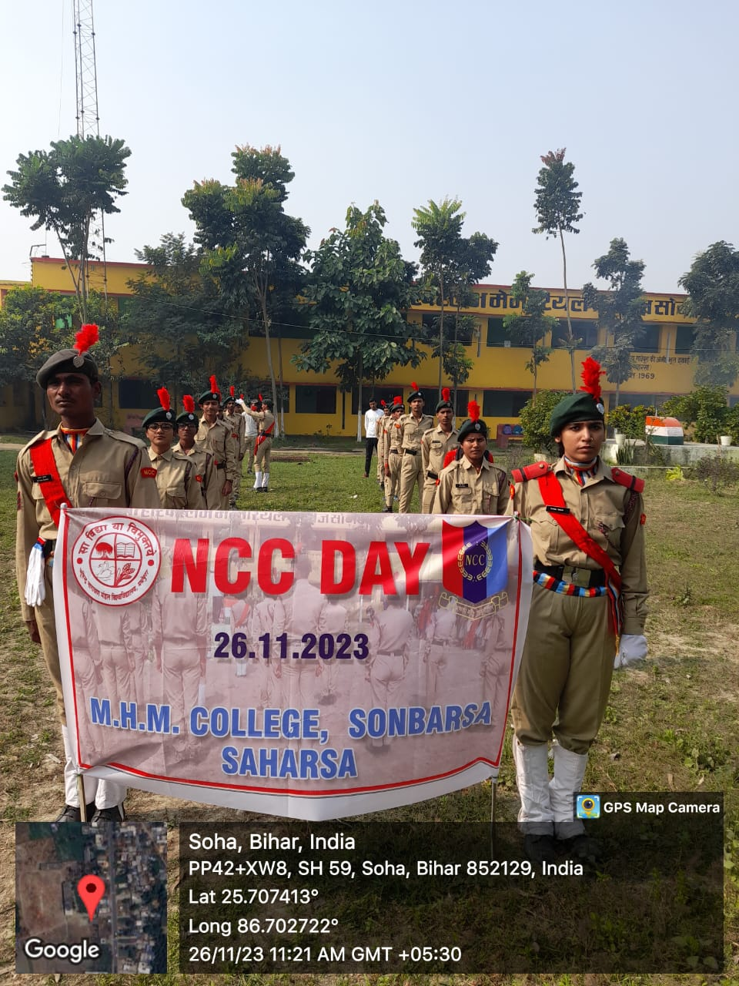

Slide 43
NSS
Relief Programme
Adopted a Village
Health Programme & Camp “Battle against cancer”/ HIV/AIDS
Environmental related Programme
Historical Sites Preservation
Orientation Programme & Swachha Bharat Aviyan
Organ Donation Workshop.
Red Ribbon Club.

Slide 45
YOUTH RED CROSS
Mini Marathon on various events
National Youth Day: 12th January
Bihar Diwas : 22 March
World No Tobacco Day : 8th May
Vana mahosthava : 19th July
International Youth Day : 12th August
Teacher’s Day : 5th September
Voluntary Blood Donation Day : 1st October
Natural Disaster Reduction Day : 29th October
World AIDS day : 1st December
International Volunteers Day : 5th December

Slide 46
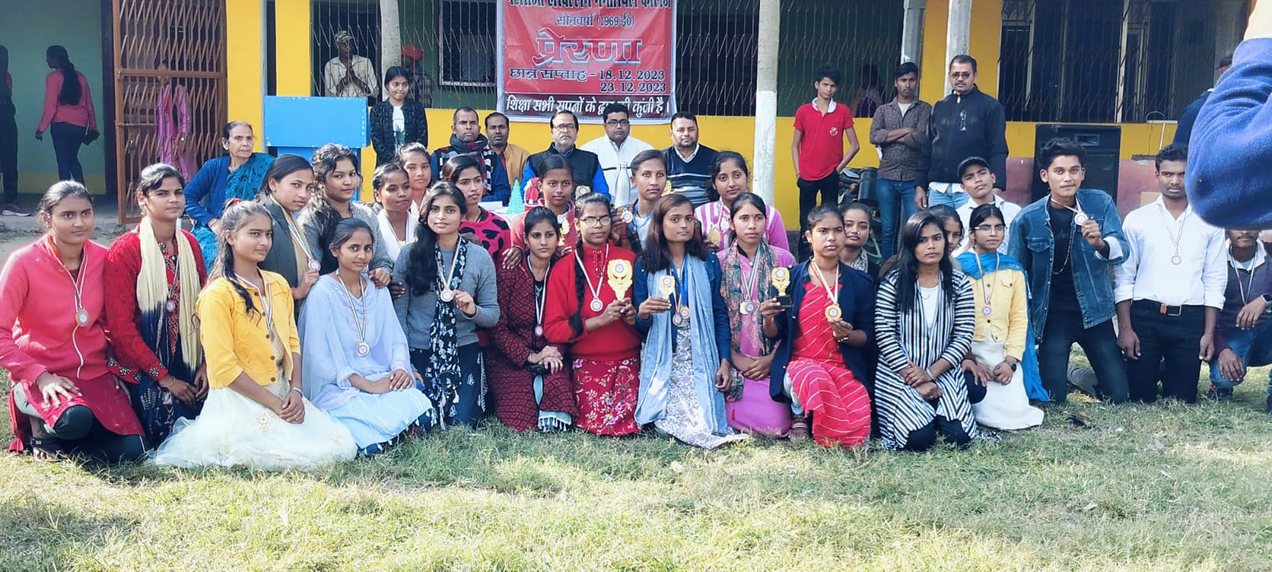
CULTURAL ACTIVITIES

Slide 49
GOVERNANCE LEADERSHIP AND MANAGEMENT

Slide 50
LEADERSHIP & MANAGEMENT
Statutory Body
- University
-Bihar Government
-Governing Body
PRINCIPAL
BURSARS /CONTROLLER OF EXAMS
HEAD CLERK
Regular meetings with Unviersity Members, and Alumni Association as per schedule.
Inputs from HODs, IQAC and Stake holders for development.
ADMINISTRATIVE & ACCOUNTS STAFF

Slide 51
STRATEGY FOR DEVELOPMENT
Academic strategy
Infrastructure Strategy
Academic Committee decides various Internal Examination
Consultation with the UGC, Govt. Of Bihar & University.
Empowerment Strategy
Empowering of Woman is done by woman empowerment cell.

Slide 52
FINANCE MANAGEMENT

Slide 53
RESOURCE MOBILISATION
SOURCES:
STATE GOVERNMENT
UGC GRANT
MP /MLA
ALUMNI
DEVELOPMENT FEES
UTILIZATION:
BUDGET IS PREPARED BASED ON PERSPECTIVE PLANS BY ACCCOUNT DEPARTMENT IN PRESCRIBED FORMAT ISSUED BY B.N. MANDAL UNIVERSITY, MADHEPURA.
PROCESS & MODE OF PAYMENT
Purchases are made through open tender and published in website/Newspapers
Major Civil works: By state Govt/Central Govt. agencies.
Payment mode : Cheques/ NEFT/RTGS.

Slide 54
FINANCIAL MANAGEMENT AND RESOURCE MOBILIZATION
MODE OF COLLECTION : All fees and fines, are collected through SBI Mobile Banking Counter at college & online through SBI e-Collect mode
AUDIT SYSTEM :
Internal audit : Accounts Bursar & Internal auditor
External Audit : Govt. of Bihar , Finance Dept.
Audit Report Compliance :Duly complied

Slide 55
INNOVATION
Examination Management Solution System.
Question setting by Internal faculty members.
Academic Calendar & Syllabus in website.

Slide 56
BEST PRACTICES
State Level Award / Felicitation for commendable contribution to the society by Shruti Kumari.
Institution won Gold Medal in Wrestling
SMS alert of all notifications

Slide 57
EMINENT PERSONALITIES VISITED OUR CAMPUS
His Excellency Dr. Prof. Awadh Kishor Rai, Former Vice Chancellor B.N.M.U. Madhepura
His Excellency Shri Ratnesh Sada, Minister of SC & ST Welfare, Bihar.
M.P. Shri Dinseh Chandra Yadav.

Slide 58
SWOC ANALYSIS

Slide 59
STRENGTH
WEAKNESS
Vast campus
Large student
Qualified and experienced faculty
Restricted freedom in curricular aspects.
Lack of adequate accommodation for boys & Girls.
English communication skill.
OPPORTUNITIES
CHALLENGES
Well placed alumni pool.
Various courses will be started
Opening of new courses.
Funds crunch.
Large classes (more than 100 students to accommodate)

Slide 60
INSTITUTION DEVELOPMENT PLAN
Construction of Women’s hostels for 500 students and an auditorium with a capacity of 1500.
To upgrade the college with B.C.A, B.P.Ed. BLISS, YOGA, and P.G. in all Subjects.

Slide 61
THANK YOU

